Slide 1
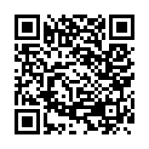
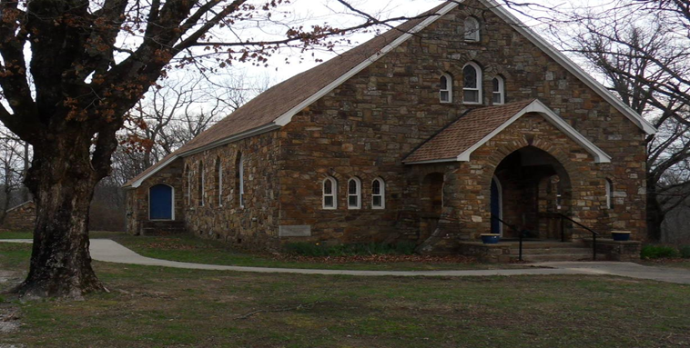
Our Lady of the Ozarks Shrine
online donations
June 21, 2026
The Twelfth Sunday in Ordinary Time
OUR LADY OF THE OZARKS SHRINE
SHRINE SCHEDULE
Adoration of the Blessed Sacrament 7:45 to 8:45AM
RECONCILLATION: 8:30AM Every Sunday
MASS: 9:00AM Every Sunday
Website: www.ourladyoftheozarksshrine.org
Mass Readings
June 22-28
Mon: 2 Kings 17:5-8, 13-15a, 18
PS: 60:3, 4-5, 12-13
Matthew 7:1-5
Tues:2 Kings 19:9b-11, 14-21, 31-35a, 36
PS: 48:2-3Ab, 3cd-4, 10-11
Matthew 7:6, 12-14
Wed: Jeremiah 1:4-10
PS: 71:1-2, 3-4a, 5-6ab, 15ab and 17
1 Peter 1:8-12
Luke 1:5-17
Thu: 2 Kings 24:8-17
PS: 79:1b-2, 3-5, 8, 9
Matthew 7:21-29
Fri: 2 Kings 25:1-12
PS: 137:1-2, 3, 4-5, 6
Matthew 8:1-4
Sat: Lamentations 2:2, 10-14, 18-19
PS: 74:1b-2, 3-5, 6-7, 20-21
Matthew 8:5-17
Sun: 2 Kings 4:8-11, 14-16a
PS: 89:2-3, 16-17, 18-19
Romans 6:3-4, 8-11
Matthew 10:37-42
Conference of Catholic Bishops website: www.usccb.org/bible
Pastor
Fr. Jason Tyler
St. Joseph
Fayetteville, AR
(479-442-0890)
Associate Pastor
Fr. Martin Dara
St. Joseph
Fayetteville, AR
(479-442-0890)
Music Director
Charles Berg
310-321-8771
Email:
charlesb1297@gmail.com
Parish Administrator
Dc. Mike Henry
(479-530-3792
Email: mhenry@coldwellbankerhmf.com
Tom Johnson
Parish Advisory
Council President
479-409-1937

Slide 2
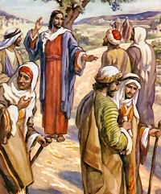
PLEASE PRAY FOR: Geri Badian, Kathy Badian, Dylan Peary, Julie Quirk, Ronnie Maynar, Greg Howard, Heather Henry, Susie Henry, Msgr. Scott Friend, William Garrett, Karen Heater, Bob Edwards, Anita Sultz, Leonard Collins, Jim Wilson & Family, Linda Crowe, Velma & Rudy Kramer, Pat & Loren Hoglund, Carolyn Marshall, Jerry Ramey & Family, Janet Foster, Anna Alexander, Kenneth Trussell, Glenn Warren,Toni, Larry Rota, J. C. Hughes, Tony Kahmann, Patsy Whitaker & grandson Ryan Dalton, Larry Sapone & Family, Kira Sanders & Children, Lisa Beshears, Doug Gillestie, Gene Strickland, Gale Bick, Mary Agnes Lario & Family, Martha & Ed Bellis, Charlene Endsley, Linda Guaine, Debbie McQuiston, Connie BeNard, Steve Raymond, Chris Cronan, Alan Torres, Azyuer Morris, Herman Laurent, Jeff Allen, Judy Jorgensen, Raine Hansen, Jim Campbell, Lynda Shipley, Rita & Tom Johnson, Olimpia Ibarra, Jerome Cruz, John Fussell, Barb Romano. Linda McKillip, Robbie Baker, Stacy North, Eileen & Tony Rota, Chuck Langland, Destiny Marshall, Bishop Anthony Taylor, Glen Jorgenson, Neelie Tanner, Steve Torres, Shirley & Pete Esch, Mark Moore, Goldia Stainbrook, Karen Moriarty, Linday Perez, Annie and Jason, LeAnne Esch Nash, Karen Heater, Chris May, Mark Luckas, Bob Dirgo, Dc. Norm DeBryin, Nercy Almanza, Martha & Dc. Brian Lachowski
June 21 June 28
Lector: Caroline Becker Erin Burney
EMC’s: Emily & Chuck Dwyer Vivian & Don Kitchen
Usher: Brad Becker* & Matt Carlson Matt Carlson* & Shaun Owen
In the today’s gospel, Christ summarized the ten commandments into two. With the same words used by Moses, He repeated the same call in our first reading: “Hear, O Israel! You shall love the Lord your God with all your heart, with all your soul…” Then, he amplified it by adding: “You shall love your neighbor as yourself.” Very important!
Withou
There is an hour of adoration before Mass on Sunday from 7:45AM to 8:45AM.
Want an answer to a question about our Catholic Faith? Go to catholic.chat and ask your question.
For free online access to the Catechism of the Catholic Church go to: usccb.org
There will be adoration of the Blessed Sacrament on the second Friday of every month from 5:30 to 6:30PM followed by a meatless potluck meal in the parish hall.
Mass Times change to 9:30AM effective July 5, 2026.
In today’s gospel, Jesus encourages us: “Do not be afraid, for everything that is now covered will be uncovered.” This includes the plans of the evil ones who constantly threaten to persecute and destroy the just. It suffices to note that Christ knows that fear and the threat of death can paralyze us. As Lord of the living and the dead, He knows that physical death is not the end. Instead, it is a transition to eternity. Hence, he further exhorts us: “Do not be afraid of those who can kill the body but cannot kill the soul. Rather, fear him who can destroy both body and soul in hell fire.”
t downplaying or denying the priority of the first commandment, humanly speaking, I think the second is very difficult. If we can obey the second, then we can, and have indeed obeyed the first. This is because, God lives in our neighbor. We cannot hate or do harm to our neighbor for any reason, and still claim we love God, or his commandments.
SPECIAL DATES:
Parish Picnic June 13, 2027
October 11, 2026 Pilgrimage
Collection: 6/14/26 $389.00
May Online Giving: $2560

