Slide 1
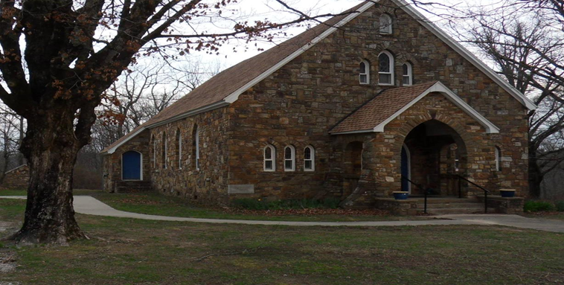
Mass Readings
January 5-11
Mon: 1 John 3:22–4:6
PS: 2:7bc-8, 10-12a
Matthew 4:12-17, 23-25
Tues: 1 John 4:7-10
PS: 72:1-2, 3-4, 7-8
Mark 6:34-44
Wed: 1 John 4:11-18
PS: 72:1-2, 10, 12-13
Mark 6:45-52
Thu: N1 John 4:19–5:4
PS: 72:1-2, 14 and 15bc, 17
Luke 4:14-22
Fri: 1 John 5:5-13
PS: 147:12-13, 14-15, 19-20
Luke 5:12-16
Sat: 1 John 5:14-21
PS: 149:1-2, 3-4, 5-6a and 9b
John 3:22-30
Sun: Isaiah 42:1-4, 6-7
PS: 29:1-2, 3-4, 3, 9-10
Acts 10:34-38
Matthew 3:13-17
Conference of Catholic Bishops website: www.usccb.org/bible
January 4, 2026
The Epiphany of the Lord
OUR LADY OF THE OZARKS SHRINE
SHRINE SCHEDULE
Adoration of the Blessed Sacrament 7:45 to 8:45AM
RECONCILLATION: 8:30AM Every Sunday
MASS: 9:00AM Every Sunday
Website: www.ourladyoftheozarksshrine.org
Pastor
Fr. Jason Tyler
St. Joseph
Fayetteville, AR
(479-442-0890)
Associate Pastor
Fr. Martin Dara
St. Joseph
Fayetteville, AR
(479-442-0890)
Music Director
Charles Berg
310-321-8771
Email:
charlesb1297@gmail.com
Parish Administrator
Dc. Mike Henry
(479-530-3792
Email: mhenry@coldwellbankerhmf.com
Tom Johnson
Parish Advisory
Council President
479-409-1937
Notes:
Daniel 7:2-14

Slide 2
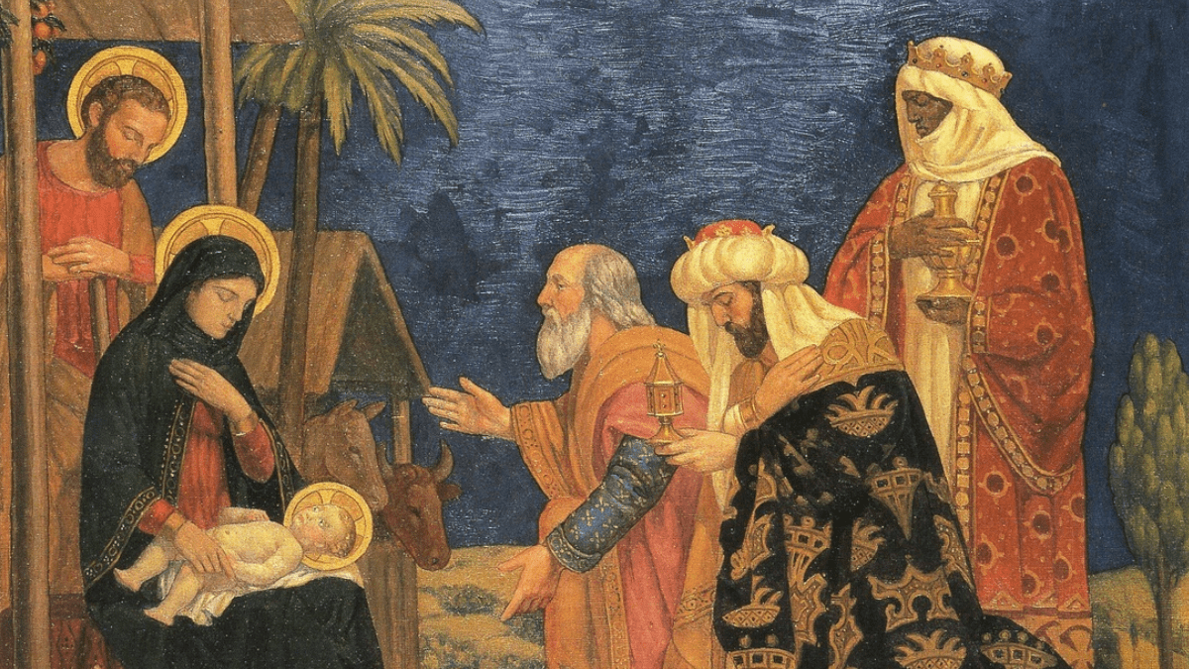
January 4 January 11
PLEASE PRAY FOR: Geri Badian, Kathy Badian, Dylan Peary, Julie Quirk, Ronnie Maynar, Greg Howard, Heather Henry, Susie Henry, Raine Hansen, Msgr. Scott Friend, William Garrett, Karen Heater, Bob Edwards, Anita Sultz, Leonard Collins, Jim Wilson & Family, Linda Crowe, Velma & Rudy Kramer, Pat & Loren Hoglund, Carolyn Marshall, Jerry Ramey & Family, Janet Foster, Anna Alexander, Kenneth Trussell, Glenn Warren,Toni, Bo & Larry Rota, J. C. Hughes, Tony Kahmann, Patsy Whitaker & grandson Ryan Dalton, Larry Sapone & Family, Kira Sanders & Children, Lisa Beshears, Doug Gillestie, Gene Strickland, Gale Bick, Mary Agnes Lario & Family, Martha & Ed Bellis, Charlene Endsley, Linda Guaine, Debbie McQuiston, Connie BeNard, Steve Raymond, Chris Cronan, Alan Torres, Azyuer Morris, Holly Allen, Herman Laurent, Jeff Allen, Judy Jorgensen, Raine Hansen, Jim Campbell, Tina Schones, Lynda Shipley, Richard Pearce, Rita & Tom Johnson, Olimpia Ibarra, Jerome Cruz, Kay Ewing, John Fussell, Barb Romano. Linda McKillip, Robbie Baker, Stacy North, Eileen & Tony Rota, Chuck Langland, Destiny Marshall, Bishop Anthony Taylor, Glen Jorgenson, Neelie Tanner, Steve Torres, Shirley & Pete Esch, Mark Moore, Goldia Stainbrook, Fr. Norman McFall, Karen Moriarty, Linday Perez, Annie and Jason, LeAnne Esch Nash, Karen Heater, Chris May, Genn John, Mark Luckas
Lector: Erin Burney Greg Burney
EMC’s: Emily Dwyer & Brad Becker Vivian and Don Kitchen
Usher: Brad Becker* & Matt Carlson Matt Carlson* & Shaun Owen
In the today’s gospel, Christ summarized the ten commandments into two. With the same words used by Moses, He repeated the same call in our first reading: “Hear, O Israel! You shall love the Lord your God with all your heart, with all your soul…” Then, he amplified it by adding: “You shall love your neighbor as yourself.” Very important!
Withou
There is an hour of adoration before Mass on Sunday from 7:45AM to 8:45AM.
Want an answer to a question about our Catholic Faith? Go to catholic.chat and ask your question.
For free online access to the Catechism of the Catholic Church go to: usccb.org
There will be adoration of the Blessed Sacrament on the second Friday of every month from 5:30 to 6:30PM followed by a meatless potluck meal in the parish hall.
January 1st is the Solemnity of Mary, the Holy Mother of God and it is a Holy day of Obligation. Mass is at 9:00AM.
The Epiphany can be looked on as a symbol for our pilgrimage through life to Christ. The feast invites us to see ourselves as images of the Magi, a people on a journey to Christ. Today’s Gospel also tells us the story of the Magi’s encounter with the evil King Herod. This encounter symbolizes three reactions to Jesus’ birth: hatred, indifference, and adoration: a) a group of people headed by Herod planned to destroy Jesus; b) another group, composed of priests and scribes, ignored Jesus; c) the members of a third group ,shepherds and the magi ,adored Jesus and offered themselves to Him.
t downplaying or denying the priority of the first commandment, humanly speaking, I think the second is very difficult. If we can obey the second, then we can, and have indeed obeyed the first. This is because, God lives in our neighbor. We cannot hate or do harm to our neighbor for any reason, and still claim we love God, or his commandments.
SPECIAL DATES:
Parish Picnic June 14, 2026
October 11, 2026 Pilgrimage
Collection: 12/28/25 $978.00
Collection for Retired Priests: $158.44
Christmas Collection: $702.00

