Slide 1
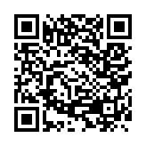
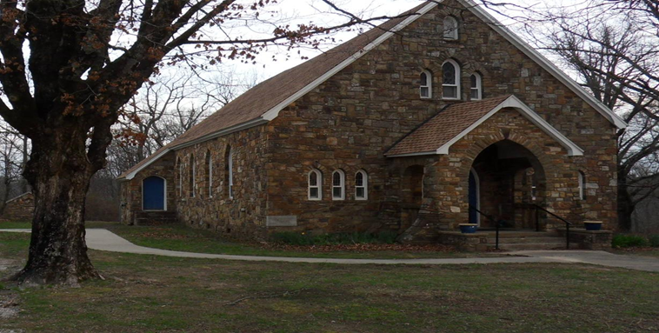
Our Lady of the Ozarks Shrine
online donations
Mass Readings
January 26-February 1
Mon: 2 Timothy 1:1-8
PS: 96:1-2a, 2b-3, 7-8a, 10
Mark 3:22-30
Tues: 2 Samuel 6:12b-15, 17-19
PS: 24:7, 8, 9, 10
Mark 3:31-35
Wed: 2 Samuel 7:4-17
PS: 89:4-5, 27-28, 29-30
Mark 4:1-20
Thu: 2 Samuel 7:18-19, 24-29
PS: 132:1-2, 3-5, 11, 12, 13-14
Mark 4:21-25
Fri: 2 Samuel 11:1-4a, 5-10a, 13-17
PS: 51:3-4, 5-6a, 6bcd-7, 10-11
Mark 4:26-34
Sat: 2 Samuel 12:1-7a, 10-17
PS: 51:12-13, 14-15, 16-17
Mark 4:35-41
Sun: Zephaniah 2:3; 3:12-13
PS: 146:6-7, 8-9, 9-10
1 Corinthians 1:26-31
Matthew 5:1-12a
Conference of Catholic Bishops website: www.usccb.org/bible
January 25, 2026
Third Sunday in Ordinary Time
OUR LADY OF THE OZARKS SHRINE
SHRINE SCHEDULE
Adoration of the Blessed Sacrament 7:45 to 8:45AM
RECONCILLATION: 8:30AM Every Sunday
MASS: 9:00AM Every Sunday
Website: www.ourladyoftheozarksshrine.org
Pastor
Fr. Jason Tyler
St. Joseph
Fayetteville, AR
(479-442-0890)
Associate Pastor
Fr. Martin Dara
St. Joseph
Fayetteville, AR
(479-442-0890)
Music Director
Charles Berg
310-321-8771
Email:
charlesb1297@gmail.com
Parish Administrator
Dc. Mike Henry
(479-530-3792
Email: mhenry@coldwellbankerhmf.com
Tom Johnson
Parish Advisory
Council President
479-409-1937
Notes:
Daniel 7:2-14

Slide 2
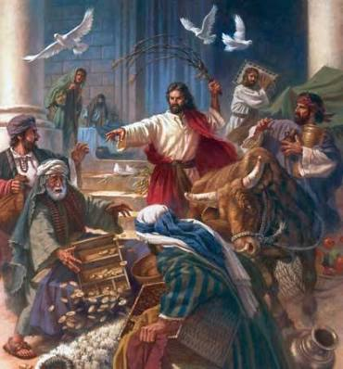
January 25 February 1
PLEASE PRAY FOR: Geri Badian, Kathy Badian, Dylan Peary, Julie Quirk, Ronnie Maynar, Greg Howard, Heather Henry, Susie Henry, Raine Hansen, Msgr. Scott Friend, William Garrett, Karen Heater, Bob Edwards, Anita Sultz, Leonard Collins, Jim Wilson & Family, Linda Crowe, Velma & Rudy Kramer, Pat & Loren Hoglund, Carolyn Marshall, Jerry Ramey & Family, Janet Foster, Anna Alexander, Kenneth Trussell, Glenn Warren,Toni, Bo & Larry Rota, J. C. Hughes, Tony Kahmann, Patsy Whitaker & grandson Ryan Dalton, Larry Sapone & Family, Kira Sanders & Children, Lisa Beshears, Doug Gillestie, Gene Strickland, Gale Bick, Mary Agnes Lario & Family, Martha & Ed Bellis, Charlene Endsley, Linda Guaine, Debbie McQuiston, Connie BeNard, Steve Raymond, Chris Cronan, Alan Torres, Azyuer Morris, Holly Allen, Herman Laurent, Jeff Allen, Judy Jorgensen, Raine Hansen, Jim Campbell, Tina Schones, Lynda Shipley, Richard Pearce, Rita & Tom Johnson, Olimpia Ibarra, Jerome Cruz, Kay Ewing, John Fussell, Barb Romano. Linda McKillip, Robbie Baker, Stacy North, Eileen & Tony Rota, Chuck Langland, Destiny Marshall, Bishop Anthony Taylor, Glen Jorgenson, Neelie Tanner, Steve Torres, Shirley & Pete Esch, Mark Moore, Goldia Stainbrook, Fr. Norman McFall, Karen Moriarty, Linday Perez, Annie and Jason, LeAnne Esch Nash, Karen Heater, Chris May, Genn John, Mark Luckas
Lector: Mary Ann Kahmann Sharon Lee
EMC’s: Sharon & Victor Lee Emily Dwyer & Brad Becker
Usher: Bill Jenkins* & Brad Becker Brad Becker* & Matt Carlson
In the today’s gospel, Christ summarized the ten commandments into two. With the same words used by Moses, He repeated the same call in our first reading: “Hear, O Israel! You shall love the Lord your God with all your heart, with all your soul…” Then, he amplified it by adding: “You shall love your neighbor as yourself.” Very important!
Withou
There is an hour of adoration before Mass on Sunday from 7:45AM to 8:45AM.
Want an answer to a question about our Catholic Faith? Go to catholic.chat and ask your question.
For free online access to the Catechism of the Catholic Church go to: usccb.org
There will be adoration of the Blessed Sacrament on the second Friday of every month from 5:30 to 6:30PM followed by a meatless potluck meal in the parish hall.
Dc. Mike will present a teaching on the Mass February 14th from 8:00AM to noon. Breakfast and lunch will be provided. Sign up if you plan to attend.
Jesus is always coming to meet us, always coming to us along the shore of our lives, as he did with his first disciples. Whether it is at work or school or time off, whether it is convenient or inconvenient, he is always calling us. It isn’t just on Sundays or while we’re at Mass, but every day! He invites us to follow him more closely today than yesterday, to be more passionate for him tomorrow than we are today!
t downplaying or denying the priority of the first commandment, humanly speaking, I think the second is very difficult. If we can obey the second, then we can, and have indeed obeyed the first. This is because, God lives in our neighbor. We cannot hate or do harm to our neighbor for any reason, and still claim we love God, or his commandments.
SPECIAL DATES:
Parish Picnic June 14, 2026
October 11, 2026 Pilgrimage
Collection: 1/18/26 $569.00

