Slide 1
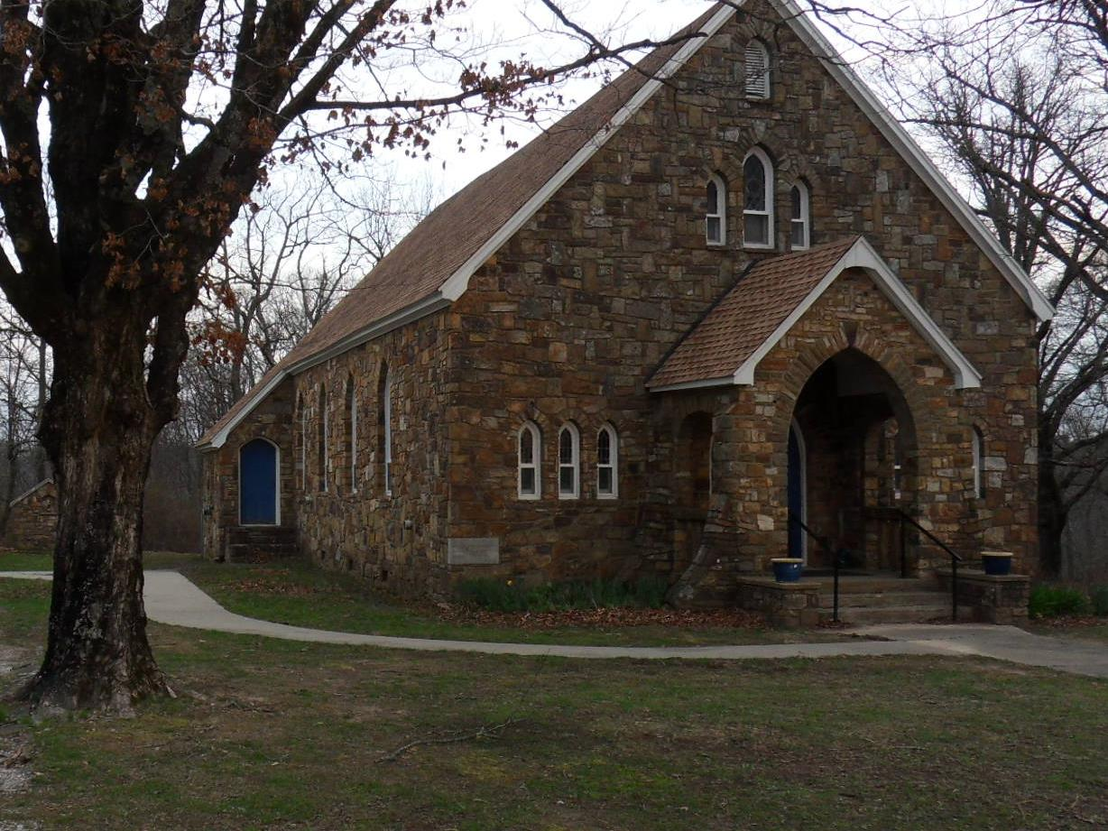
July 27, 2025
Seventeenth Sunday in Ordinary Time
OUR LADY OF THE OZARKS SHRINE
SHRINE SCHEDULE
Adoration of the Blessed Sacrament 7:45 to 8:45AM
RECONCILLATION: 8:30AM Every Sunday
MASS: 9:00AM Every Sunday
Website: www.ourladyoftheozarksshrine.org
Mass Readings
July 28-August 3
Mon: Exodus 32:15-24, 30-34
PS: 106:19-20, 21-22, 23
Matthew 13:31-35
Tues: Exodus 33:7-11; 34:5b-9, 28
PS: 103:6-7, 8-9, 10-11, 12-13
John 11:19-27
Wed: Exodus 34:29-35
PS: 99:5, 6, 7, 9
Matthew 13:44-46
Thu: Exodus 40:16-21, 34-38
PS: 84:3, 4, 5-6a and 8a, 11
Matthew 13:47-53
Fri: Leviticus 23:1, 4-11, 15-16, 27, 34b-37
PS: 81:3-4, 5-6, 10-11ab
Matthew 13:54-58
Sat:Leviticus 25:1, 8-17
PS: 67:2-3, 5, 7-8
Matthew 14:1-12
Sun: Ecclesiastes 1:2; 2:21-23
PS: 90:3-4, 5-6, 12-13, 14 and 17
Colossians 3:1-5, 9-11
Luke 12:13-21
Conference of Catholic Bishops website: www.usccb.org/bible
Pastor
Fr. Jason Tyler
St. Joseph
Fayetteville, AR
(479-442-0890)
Music Director
Charles Berg
310-321-8771
Email:
charlesb1297@gmail.com
Associate Pastor
Fr. Martin Dara
St. Joseph
Fayetteville, AR
(479-442-0890)
Parish Administrator
Dc. Mike Henry
(479-530-3792
Email: mhenry@coldwellbankerhmf.com
Tom Johnson
Parish Advisory
Council President
479-409-1937

Slide 2
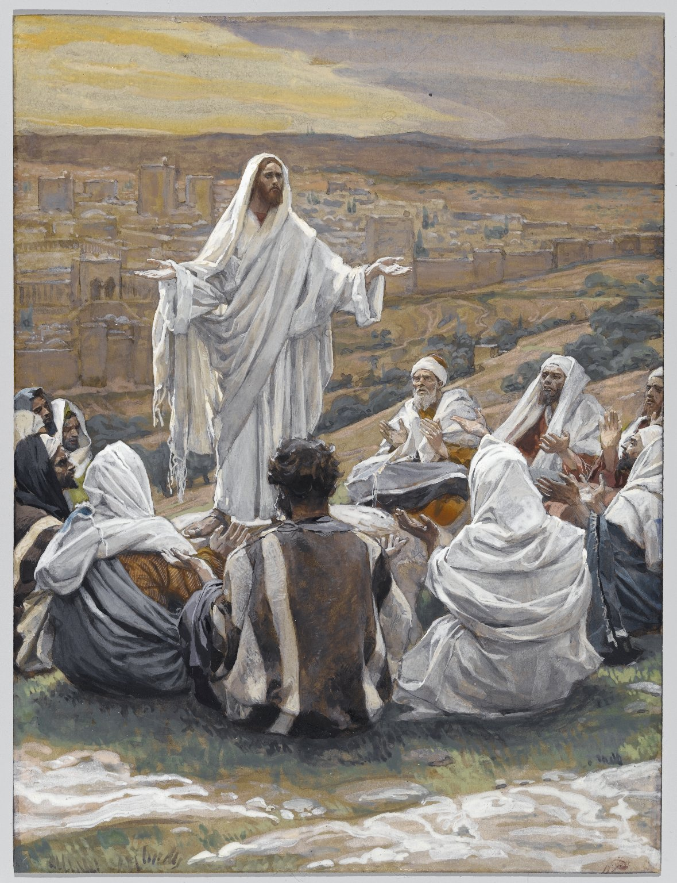
PLEASE PRAY FOR: Geri Badian, Kathy Badian, Dylan Peary, Julie Quirk, Ronnie Maynar, Greg Howard, Heather Henry, Susie Henry, Raine Hansen, Msgr. Scott Friend, William Garrett, Karen Heater, Bob Edwards, Anita Sultz, Leonard Collins, Jim Wilson & Family, Linda Crowe, Velma & Rudy Kramer, Pat & Loren Hoglund, Carolyn Marshall, Jerry Ramey & Family, Janet Foster, Anna Alexander, Kenneth Trussell, Glenn Warren,Toni, Bo & Larry Rota, J. C. Hughes, Tony Kahmann, Patsy Whitaker & grandson Ryan Dalton, Larry Sapone & Family, Kira Sanders & Children, Lisa Beshears, Doug Gillestie, Gene Strickland, Gale Bick, Mary Agnes Lario & Family, Martha & Ed Bellis, Charlene Endsley, Linda Guaine, Debbie McQuiston, Connie BeNard, Steve Raymond, Chris Cronan, Alan Torres, Azyuer Morris, Holly Allen, Nancy and Herman Laurent, Jeff Allen, Judy Jorgensen, Raine Hansen, Jim Campbell, Tina Schones, Lynda Shipley, Richard Pearce, Rita & Tom Johnson, Olimpia Ibarra, Jerome Cruz, Kay Ewing, John Fussell, Barb Romano. Linda McKillip, Robbie Baker, Stacy North, Eileen & Tony Rota, Chuck Langland, Destiny Marshall, Bishop Anthony Taylor, Glen Jorgenson, Neelie Tanner, Steve Torres, Shirley & Pete Esch, Mark Moore, Goldia Stainbrook, Fr. Norman McFall, Karen Moriarty
Sunday July 27 Sunday August 3
Lector: Victor Lee Tony Romano
EMC’s: Emily Dwyer & Janet Foster Vivian & Don Kitchen
Usher: Matt Carlson* Shaun Owen Shaun Owen* & Bill Jenkins
There is an hour of adoration before Mass on Sunday from 7:45AM to 8:45AM.
Want an answer to a question about our Catholic Faith? Go to catholic.chat and ask your question.
For free online access to the Catechism of the Catholic Church go to: usccb.org
There will be adoration of the Blessed Sacrament on the second Friday of every month from 5:30 to 6:30PM followed by a meatless potluck meal in the parish hall.
In the today’s gospel, Christ summarized the ten commandments into two. With the same words used by Moses, He repeated the same call in our first reading: “Hear, O Israel! You shall love the Lord your God with all your heart, with all your soul…” Then, he amplified it by adding: “You shall love your neighbor as yourself.” Very important!
Withou
One of the petitions in the Lord’s Prayer is to give our daily bread. Here we are asking not only nourishing for our body but also for our soul. Of course, ultimately the super-essential nourishment for our soul is the Eucharist.
t downplaying or denying the priority of the first commandment, humanly speaking, I think the second is very difficult. If we can obey the second, then we can, and have indeed obeyed the first. This is because, God lives in our neighbor. We cannot hate or do harm to our neighbor for any reason, and still claim we love God, or his commandments.
SPECIAL DATES:
Parish Picnic June 14, 2026
October 12, 2025 Pilgrimage
Collection: 7-20-25 $1109.00

