Slide 1
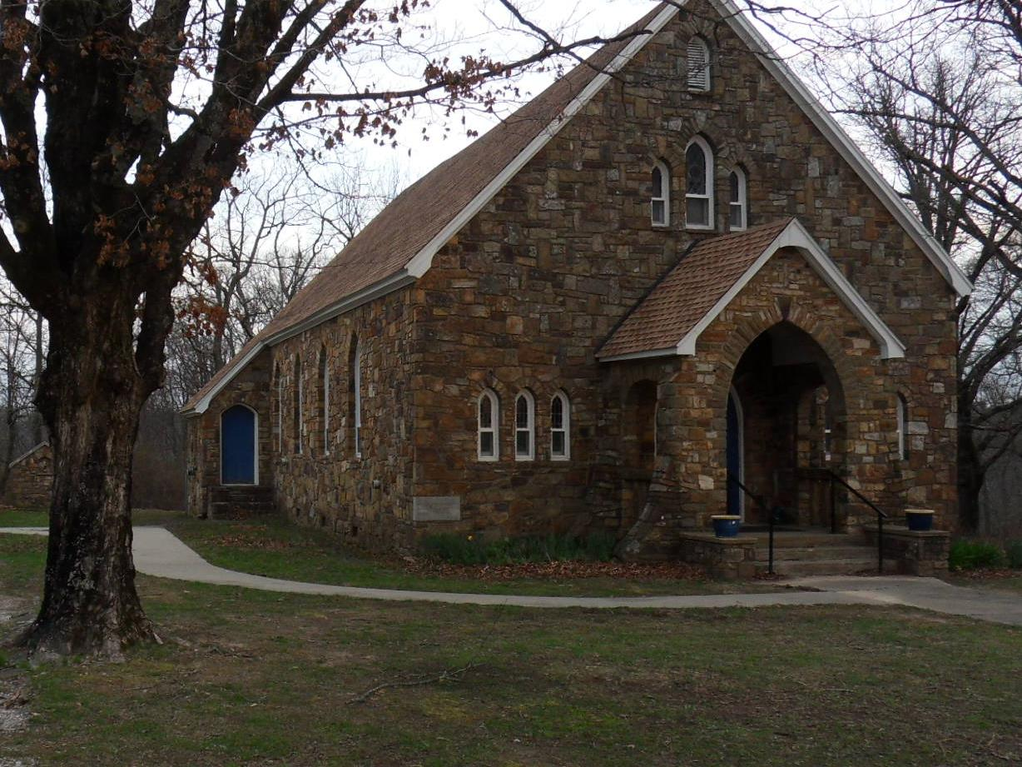
April 13, 2025
Palm Sunday
OUR LADY OF THE OZARKS SHRINE
SHRINE SCHEDULE
Adoration of the Blessed Sacrament 7:45 to 8:45AM
RECONCILLATION: 8:30AM Every Sunday
MASS: 9:00AM Every Sunday
Website: www.ourladyoftheozarksshrine.org
Mass Readings
April 14-20
Mon: Isaiah 42:1-7
PS: 27:1, 2, 3, 13-14
John 12:1-11
Tues: Isaiah 49:1-6
PS: 71:1-2, 3-4a, 5ab-6ab, 15 and 17
John 13:21-33, 36-38
Wed: Isaiah 50:4-9a
PS: 69:8-10, 21-22, 31 and 33-34
Matthew 26:14-25
Thu: Exodus 12:1-8, 11-14
PS: 116:12-13, 15-16bc, 17-18.
1 Corinthians 11:23-26
John 13:1-15
Fri: Isaiah 52:13—53:12
PS: 31:2, 6, 12-13, 15-16, 17, 25
Hebrews 4:14-16; 5:7-9
John 18:1—19:42
Sat: Genesis 1:1—2:2
PS: 104:1-2, 5-6, 10, 12, 13-14, 24, 35
Genesis 22:1-18
Luke 24:1-12
Sun: Acts 10:34a, 37-43
PS: 118:1-2, 16-17, 22-23
Colossians 3:1-4
John 20:1-9
Conference of Catholic Bishops website: www.usccb.org/bible
Pastor
Fr. Jason Tyler
St. Joseph
Fayetteville, AR
(479-442-0890)
Music Director
Charles Berg
310-321-8771
Email:
charlesb1297@gmail.com
Associate Pastor
Fr. Martin Dara
St. Joseph
Fayetteville, AR
(479-442-0890)
Parish Administrator
Dc. Mike Henry
(479-530-3792
Email: mhenry@coldwellbankerhmf.com
Tom Johnson
Parish Advisory
Council President
479-409-1937

Slide 2
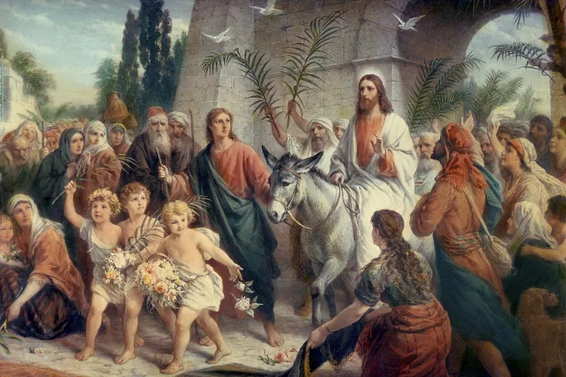
Sunday April 13 Sunday April 20
PLEASE PRAY FOR: Geri Badian, Kathy Badian, Dylan Peary, Julie Quirk, Ronnie Maynar, Greg Howard, Heather Henry, Susie Henry, Raine Hansen, Msgr. Scott Friend, William Garrett, Lanny & Karen Heater, Bob Edwards, Anita Sultz, Leonard Collins, Jim Wilson & Family, Linda Crowe, Velma & Rudy Kramer, Pat & Loren Hoglund, Carolyn Marshall, Jerry Ramey & Family, Janet Foster, Anna Alexander, Kenneth Trussell, Glenn Warren,Toni, Bo & Larry Rota, J. C. Hughes, Tony Kahmann, Patsy Whitaker & grandson Ryan Dalton, Larry Sapone & Family, Kira Sanders & Children, Lisa Beshears, Doug Gillestie, Gene Strickland, Gale Bick, Mary Agnes Lario & Family, Martha & Ed Bellis, Charlene Endsley, Linda Guaine, Debbie McQuiston, Connie BeNard, the Johnson Family, Steve Raymond, Chris Cronan, Alan Torres, Azyuer Morris, Holly Allen, Nancy and Herman Laurent, Jeff Allen, Judy Jorgensen, Raine Hansen, Toni Hansen, Jim Campbell, Tina Schones, Lynda Shipley, Richard Pearce, Rita & Tom Johnson, Olimpia Ibarra, Jerome Cruz, Kay Ewing, John Fussell, Barb Romano. Linda McKillip, Robbie Baker, Stacy North, Eileen & Tony Rota, Chuck Langland, Destiny Marshall, Patti Titcombe, Genn John, Bishop Anthony Taylor, Glen Jorgenson, Neelie Tanner, Steve Torres, Shirley & Pete Esch, Mark Moore, Esther Leverton, Goldia Stainbrook
Lector: Don Kitchen Mary Ann Kahmann
EMC’s: Tony Romano & Brad Becker Emily Dwyer a& Janet Foster
Usher: Alan Laiche* & Bill Jenkins Bill Jenkins* & Brad Becker
There is an hour of adoration before Mass on Sunday from 7:45AM to 8:45AM.
Want an answer to a question about our Catholic Faith? Go to catholic.chat and ask your question.
For free online access to the Catechism of the Catholic Church go to: usccb.org
There will be adoration of the Blessed Sacrament on the second Friday of every month from 5:30 to 6:30PM followed by a meatless potluck meal in the parish hall.
April 17th is Holy Thursday. Mass is at 6:00PM. April 18th is Good Friday. The Good Friday service is at 6:00PM.
Saturday April 19th is M&N Augustine Foundation Easter Feed, we will provide 2000 meals. Rita will hand out Turkeys after Mass, if anyone wants to cook for this event. See Rita Johnson
Flowers for Easter Sunday. If anyone would like to place flowers at the alter in honor of a loved one, just bring them before Mass, and place them at the foot of the altar. They can be fresh vases, or blooming plants. For more info see Rita Johnson
In the today’s gospel, Christ summarized the ten commandments into two. With the same words used by Moses, He repeated the same call in our first reading: “Hear, O Israel! You shall love the Lord your God with all your heart, with all your soul…” Then, he amplified it by adding: “You shall love your neighbor as yourself.” Very important!
Withou
Today we celebrate the “Palm Sunday of the Lord’s Passion.” Our celebration started differently today with a gospel reading outside of church followed by our procession into the church to re-enact Jesus’ jubilant and triumphant entry into Jerusalem. By the time of the regular gospel reading (The Passion Narrative), jubilation disappeared as we recalled Jesus’ suffering and death. But wait, let us ask “what happed between these two gospel readings? Did the crowd do a complete turnaround? Because we have a crowd shouting “Hosanna! Hosanna!!!” as Jesus processed into Jerusalem.
t downplaying or denying the priority of the first commandment, humanly speaking, I think the second is very difficult. If we can obey the second, then we can, and have indeed obeyed the first. This is because, God lives in our neighbor. We cannot hate or do harm to our neighbor for any reason, and still claim we love God, or his commandments.
SPECIAL DATES:
Parish Picnic June 15, 2025
October 12, 2025 Pilgrimage
Collection: 4-6-25 $1251.00

