Slide 1
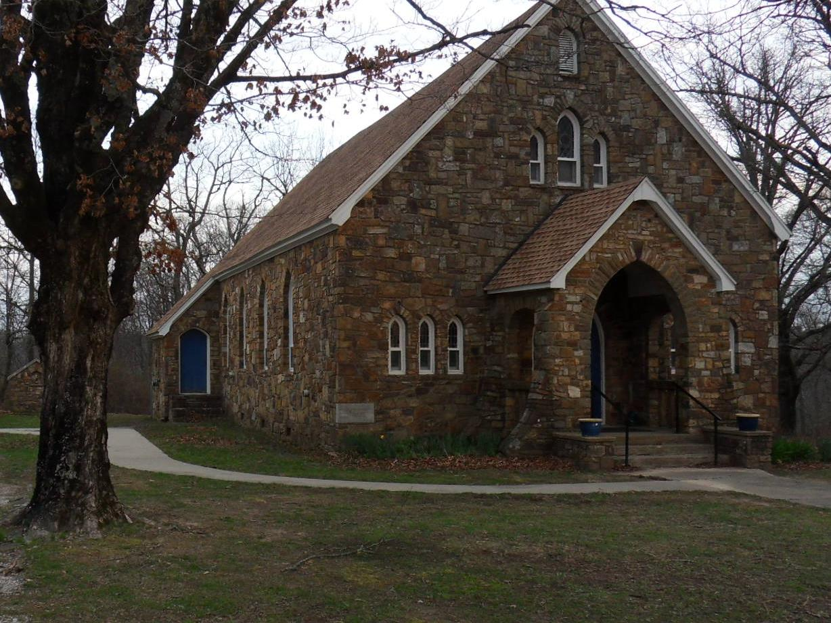
March 2, 2025
The Eighth Sunday in Ordinary Time
OUR LADY OF THE OZARKS SHRINE
SHRINE SCHEDULE
Adoration of the Blessed Sacrament 7:45 to 8:45AM
RECONCILLATION: 8:30AM Every Sunday
MASS: 9:00AM Every Sunday
Website: www.ourladyoftheozarksshrine.org
Mass Readings
March 3-9
Mon: Sirach 17:20-24
PS: 32:1-2, 5, 6, 7
Mark 10:17-27
Tues: Sirach 35:1-12
PS: 50:5-6, 7-8, 14, 23
Mark 10:28-31
Wed: Joel 2:12-18
PS: 51:3-4, 5-6ab, 12-13, 14 and 17
2 Corinthians 5:20—6:2
Matthew 6:1-6, 16-18
Thu: Deuteronomy 30:15-20
PS: 1:1-2, 3, 4 and 6
Luke 9:22-25
Fri: Isaiah 58:1-9a
PS: 51:3-4, 5-6ab, 18-19
Matthew 9:14-15
Sat: Isaiah 58:9b-14
PS: 86:1-2, 3-4, 5-6
Luke 5:27-32
Sun: Deuteronomy 26:4-10
PS: 91:1-2, 10-11, 12-13, 14-15
Romans 10:8-13
Luke 4:1-13
Conference of Catholic Bishops website: www.usccb.org/bible
Pastor
Fr. Jason Tyler
St. Joseph
Fayetteville, AR
(479-442-0890)
Music Director
Charles Berg
310-321-8771
Email:
charlesb1297@gmail.com
Associate Pastor
Fr. Martin Dara
St. Joseph
Fayetteville, AR
(479-442-0890)
Parish Administrator
Dc. Mike Henry
(479-530-3792
Email: mhenry@coldwellbankerhmf.com
Tom Johnson
Parish Advisory
Council President
479-409-1937

Slide 2
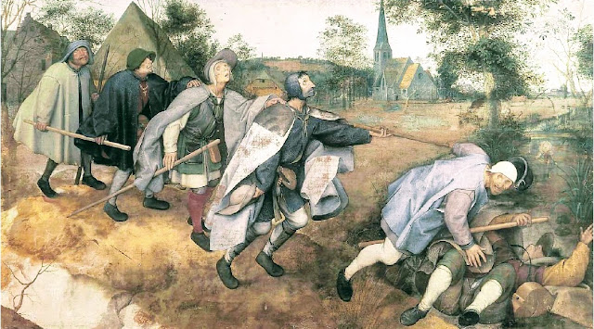
Sunday March 2 Sunday March 9
PLEASE PRAY FOR: Geri Badian, Kathy Badian, Dylan Peary, Julie Quirk, Ronnie Maynar, Greg Howard, Heather Henry, Susie Henry, Raine Hansen, Msgr. Scott Friend, William Garrett, Lanny & Karen Heater, Bob Edwards, Anita Sultz, Leonard Collins, Jim Wilson & Family, Linda Crowe, Velma & Rudy Kramer, Pat & Loren Hoglund, Carolyn Marshall, Jerry Ramey & Family, Janet Foster, Anna Alexander, Kenneth Trussell, Glenn Warren,Toni, Bo & Larry Rota, J. C. Hughes, Tony Kahmann, Patsy Whitaker & grandson Ryan Dalton, Larry Sapone & Family, Kira Sanders & Children, Lisa Beshears, Doug Gillestie, Gene Strickland, Gale Bick, Mary Agnes Lario & Family, Martha & Ed Bellis, Charlene Endsley, Linda Guaine, Debbie McQuiston, Connie BeNard, the Johnson Family, Steve Raymond, Chris Cronan, Alan Torres, Azyuer Morris, Holly Allen, Nancy and Herman Laurent, Jeff Allen, Jose Blanco, Judy Jorgensen, Raine Hansen, Toni Hansen, Jim Campbell, Tina Schones, Lynda Shipley, Richard Pearce, Rita & Tom Johnson, Olimpia Ibarra, Andy Nickell, Jerome Cruz, Kay Ewing, John Fussell, Barb Romano. Linda McKillip, Robbie Baker, Stacy North, Eileen & Tony Rota, Chuck Langland, Destiny Marshall, Patti Titcombe, Genn John, Bishop Anthony Taylor, Glen Jorgenson, Neelie Tanner, Donna Draper, Steve Torres, Pete Esch, Judy Robertson, Tom Hennely, Mark Moore, Esther Leverton
Lector: Don Kitchen Mary Ann Kahmann
EMC’s: Sharon & Victor Lee Tony Romano & Brad Becker
Usher: Brad Becker* & Matt Carlson Matt Carlson* & Alan Laiche
There is an hour of adoration before Mass on Sunday from 7:45AM to 8:45AM.
Want an answer to a question about our Catholic Faith? Go to catholic.chat and ask your question.
For free online access to the Catechism of the Catholic Church go to: usccb.org
There will be adoration of the Blessed Sacrament on the second Friday of every month from 5:30 to 6:30PM followed by a meatless potluck meal in the parish hall.
Lent begins on Ash Wednesday, March 5th. Mass and distribution of ashes is at 6:00PM.
Stations of the Cross every Friday of Lent starting at 6:00PM, followed by a light meatless dinner in the parish hall.
In the today’s gospel, Christ summarized the ten commandments into two. With the same words used by Moses, He repeated the same call in our first reading: “Hear, O Israel! You shall love the Lord your God with all your heart, with all your soul…” Then, he amplified it by adding: “You shall love your neighbor as yourself.” Very important!
Withou
The blind cannot lead the blind. A disciple cannot be a good disciple unless he or she has learned from the teacher. Everyone who is fully trained is like the teacher who knows how to cure the blind. Before you can be a good disciple and teach others you must take care of yourself. Do not try to take a speck out of your brother’s eye until you have taken the board out of your own. Finally, only when you have purified yourself can you produce the good works that the teacher requires. Discipleship asks us to produce good deeds. But to produce them requires the integrity and purity of heart found in the teacher. When people see your good deeds they will know that this is because you have a good heart.
t downplaying or denying the priority of the first commandment, humanly speaking, I think the second is very difficult. If we can obey the second, then we can, and have indeed obeyed the first. This is because, God lives in our neighbor. We cannot hate or do harm to our neighbor for any reason, and still claim we love God, or his commandments.
SPECIAL DATES:
Parish Picnic June 15, 2025
October 12, 2025 Pilgrimage
Collection: 2-23-25 $1340.00

